Slide 1



Analog Interfacing and Industrial Control
Military Institute of Science and Technology Department of Computer Science and Engineering
Course Name: Computer Interfacing
Course Code: CSE-405

Slide 2
Book Reference
❏ Microprocessor and Interfacing- Douglas V. Hall (Chapter 10)

Slide 3

Embedded System

Slide 4
Introduction
A computer hardware system having software embedded in it.
A microcontroller or microprocessor based system which is designed to perform a specific task.
either as an independent system or as a part of a large system.
At the core is an integrated circuit designed to carry out computation for real-time operations.
An embedded system has three components
It has hardware.
It has application software.
It has Real Time Operating system (RTOS) that defines the way the system works.
It sets the rules during the execution of application program.
https://www.digi.com/blog/post/examples-of-embedded-systems

Slide 5
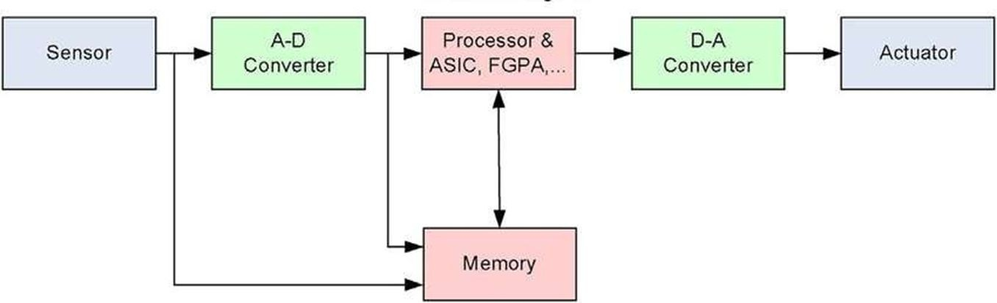
Basic Structure of An Embedded System

Slide 6
Basic Structure of An Embedded System
Sensor: It measures the physical quantity and converts it to an electrical signal which can be read by an observer or by any electronic instrument like an A/D converter. A sensor stores the measured quantity to the memory.
A-D Converter: An analog-to-digital converter converts the analog signal sent by the sensor into a digital signal.
Processor & ASICs: Processors process the data to measure the output and store it to the memory.
D-A Converter: A digital-to-analog converter converts the digital data fed by the processor to analog data
Actuator: An actuator converts an electrical signal into physical action (movement, heat, pressure, rotation, etc.). It executes commands from the processor to control the physical world.

Slide 7
D/A Converter

Slide 8
D/A Converter: Operation
The purpose of a Digital to Analog converter is to convert a binary word to a proportional current or voltage.
In a simple 4 bit D/A converter , inverting input of the circuit is referred to as the summing point.
When one of the switches is closed, current will flow from -V to the summing point.
The equation of O/P voltage, V_{out} = - Rf/ R (V_{ref} )
If we close the switch D0 , V_{out} = - 10/ 100(-5) = 0.5 V
If we close the switch D0 & D1 , V_{out} = - 10/ 33.33(-5) = 1.5 V
The point here is that, binary weighted resistors produce currents which are summed by the op amp to produce a proportional output voltage
The heart of a D/A converter is a set of binary weighted current sources which can be switched on or off according to a binary word applied to its input

Slide 9
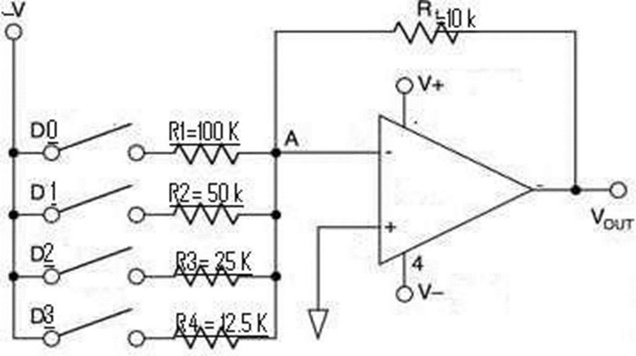
D/A Converter

Slide 10
D/A Converter: Characteristics
Resolution
This is determined by the number of bits in the input binary word.
A converter with 8 binary inputs has 2⁸ output levels.
Thus its resolution is 1 part in 256.
Example:
12 bit converter has a resolution of 1 part in 2¹² or 4096.
Resolution is sometimes expressed in percentage.
The resolution of an 8 bit converter can be expressed as a percentage is (1/256)*100 percent or 0.39 percent.

Slide 11
D/A Converter: Characteristics
Full scale output voltage
The maximum output voltage of a converter will always have a value 1 least
significant bit less than the named value.
Example:
12 bit, 10-V converter
The value of 1 LSB = (10V)/4096 = 2.44mV
The highest voltage output for the converter when it is properly adjusted will then be
: (10 – 0.0024)V or 9.9976V.

Slide 12
D/A Converter: Characteristics
Example:
Q) An n bit D/A converter has full scale output of 5V. But actually it is 4.6875V. what is the value of n?
A) Actual output = full scale output - (full scale output / 2^n) 4.6875 = 5 - 5/(2^n)-1
So, n=4
value of 1 LSB = (10V)/4096 = 2.44mV
The highest voltage output for the converter when it is properly adjusted will then be
: (10 – 0.0024)V or 9.9976V.

Slide 13
D/A Converter: Characteristics
Accuracy
The accuracy specification for a D/A converter is a comparison between the actual output and the expected output
It is specified as a percentage of the full scale output voltage or current
Example
If the converter has a output of 10V and ± 0.2 percent accuracy
Maximum error for any output will be 0.002 * 10V or 20mV
Linearity
Linearity is the measure of how much the output ramp deviates from a straight line as the converter is stepped from no switches on to all switches on.
Ideally the deviation of the output from a straight line should be no greater than ± ½ the value of LSB to maintain overall accuracy

Slide 14
D/A Converter: Characteristics
Settling Time
When we change the binary word applied to the input of a converter , the output will change to the appropriate new value
The output may overshoot the correct value, “ring” for a while before finally settling down to the correct value
The time the output takes to get within ± ½ LSB of the final value is called settling time
This specification is important, because if a converter is operated at too high frequency, it may not have time to settle to one value before it is switched to the next

Slide 15
D/A Converter: Interfacing to Microcomputers
The inputs of the D/A circuit can be connected directly to the microcomputer output port.
Thus interfacing an 8 bit converter involves simply connecting the inputs of the converter to an output port.
For some application we need to interface a 12 bit converter to a microcomputer.
If we are working with a system which has an 8 bit data bus
The first thought might be – to connect the lower 8 inputs of the 12 bit converter to one output port and upper 4 bits to another port
In that case, we could send the lower 8 bits with one write operation and the upper 4 bits with another write operation
Time between the two writes introduces a potential problem in this approach

Slide 16
D/A Converter: Interfacing to Microcomputers
Example:
Suppose we want to change the pattern of a 12 bit converter from 0000 1111 1111 to 0001 0000 0000
When we will write the lower 8 bits, the output will go from 0000 1111 1111 to 0000 0000 0000
When we will write the upper 4 bits the output will go back up to the desired 0001 0000 0000
The point here is that for the time between the two writes the output will go to an unwanted value
In many systems this could be disastrous
The cure of this problem is to put latches on the input lines
The latches can be loaded separately and then strobed together to pass all 12 bits to the D/A converter at the same time

Slide 17
Thank You

